Slide 1
FLIP ROBO
HOUSING PROJECT

Slide 2
PROBLEM STATEMENT
BUILDING A MACHINE LEARNING MODEL TO PREDICT THE HOUSE PRICES USING THE GIVEN INDEPENDENT VARIABLES.

Slide 3
EDA STEPS AND VISUALIZATIONS
Columns 'Alley', 'PoolQC', 'MiscFeature’, 'FireplaceQu', 'Fence' has very high number of null values. So we are dropping these columns.
Still there are columns containing null values. They are replaced with mean in case of numerical values and mode in case of nominal values.

Slide 4
DATASETS USED FOR TRAINING PURPOSE
df_rev → All columns that has very low(<0.15) correlation with the target has been removed. Also columns having high multi collinearity has been removed. This dataset was used for Linear, Ridge, Lasso regression testing.
df_irev→ Only those columns whose visualizations shows very less relevance with the target variable has been removed. 'MoSold','MasVnrType','Id','YrSold','LotConfig‘ columns has been removed. This dataset was used for algorithms like Random Forest Regressor, Knearest Neighbor etc.

Slide 5
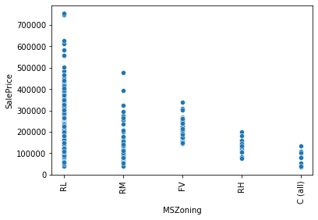
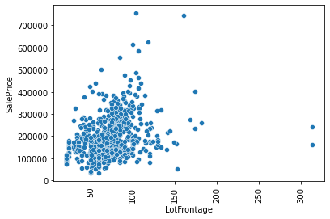
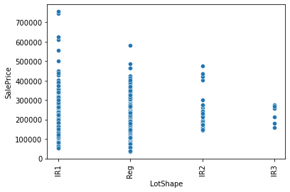
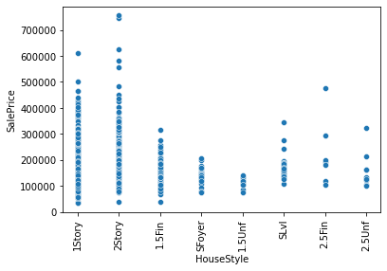
SOME VISUALIZATIONS

Slide 6
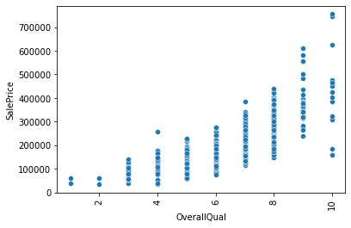
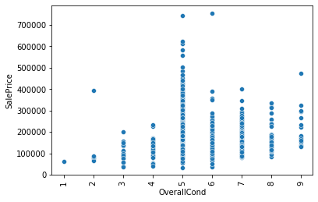
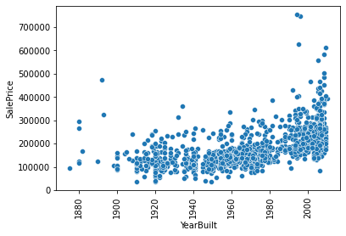
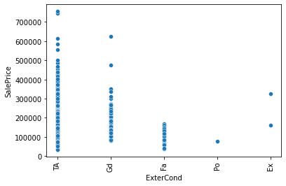
SOME MORE VISUALIZATIONS

Slide 7
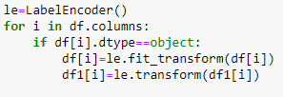
PRE-PROCESSING LABEL ENCODING
Label encoding was done on all the columns containing nominal data. fit_transform was applied on training data and transform was applied on test data.

Slide 8
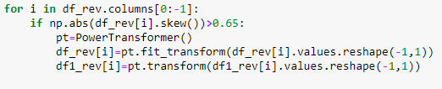
PRE PROCESSING POWER TRANSFORMER
Power Transformer was applied on columns having skewness more than 0.65 or less than
-0.65
Fit_transform was applied on training data and tranform was applied on testing data.
It was applied on both datasets df_rev and df_irev.

Slide 9
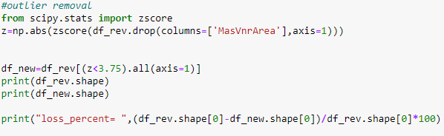
OUTLIER REMOVAL
Keeping absolute value of z<3 was resulting in huge loss of data in df_rev. So we increased the value to 3.75

Slide 10
MODEL TRAINING
Different models were trained and hyper-parameter tuning was done on them.
ML model | Best R2_score
Linear Regression | 0.918
Ridge Regression Lasso Regression | 0.901 0.901
KNN Regressor | 0.904
Random Forest Regressor | 0.927

Slide 11
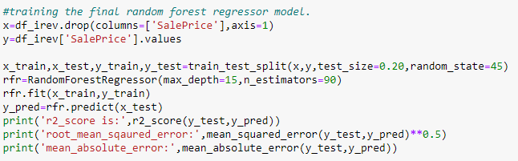
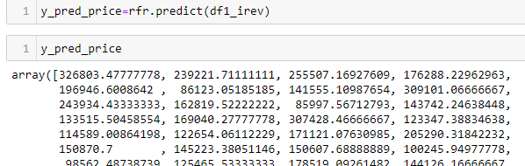
FINAL MODEL
Since Random Forest Regressor gave the best results. We are finalising the model and applying it on the test data.

Slide 12
CONCLUSION
There were many columns which had low correlation with the target. They gave bad results with LinearRegression like algorithms but gave good results with algorithms like random forest regressor.
It is better to test as many combination of columns as possible until we get the best possible results.

Slide 14
Thank you

